Slide 1

Overview
Group 1

Slide 2
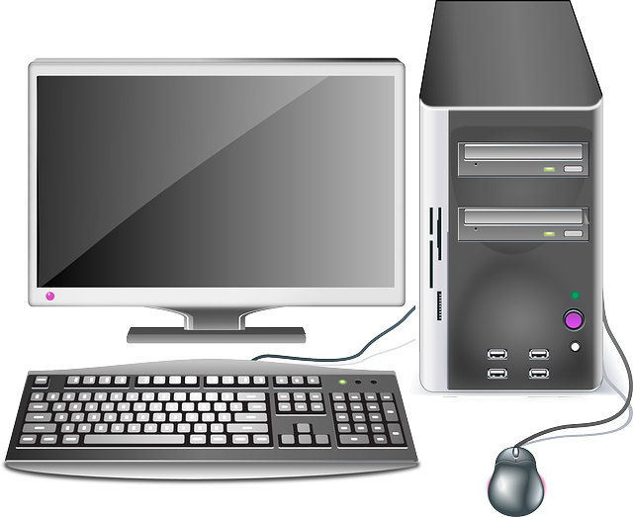
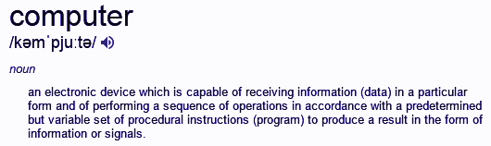
What is a Computer?
A computer generally means a programmable machine. The two main properties of a computer are that it responds to a specific set of instructions given to it in an orderly way and it can execute a pre-scripted list of instructions called a program or script.
Modern computers are all electronic and digital. much more compact than they used to be. The actual machinery (the wires, transistors, and circuits) is called the hardware while the instructions, programs and data are called software.

Slide 3
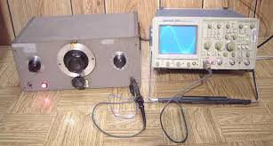
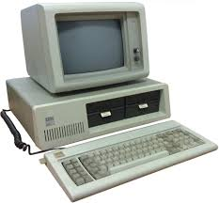
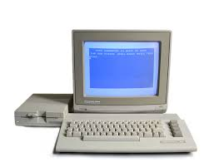
History of Computers
1939 - Hewlett-Packard(HP) is founded in Palo Alto, California. This is where the HP 200A Audio Oscillator, i.e. the first computer was born.
1981- IBM introduce their own PC which was the ignited the start of the demand for Personal Computers.
1983 - Commodore introduce the Commodore 64 (C64). This computer was sold $595 which included 64KB of RAM, and sold over 22,000,000 units in its 11 year lifespan on the market.
1977 - Steve Wozniak

Slide 4
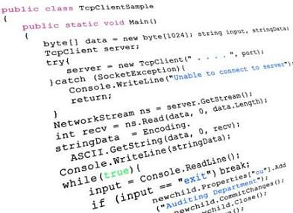
What is a Computer Program?
A Computer Program is a sequence of written instructions that tell a computer to execute a specific task.
Without programs, computers are just machines that can perform mathematical calculations very quickly.
A computer requires programs to function the way we want them to.
These programs are executed by the computer’s
Central Processing Unit.
In order to create programs we need a way that is
readable by humans. This is called source code.

Slide 5
History of Programming
The Analytical Engine appended a set of notes which specified in complete detail a method for calculating Bernoulli numbers with the Analytical Engine, recognized by some historians as the world's first computer program.
In the 1940s the first recognisably modern electrical computers were made. Because they had limited speed and memory, programmers had to write had tuned programmes.
The rapid growth of the Internet in the mid-1990s was the next major historic event in programming languages. By opening up a radically new platform for computer systems, the Internet created an opportunity for new languages to be adopted. In particular, the JavaScript programming language rose to popularity because of its early integration with the Netscape Navigator web browser. Various other scripting languages achieved widespread use in developing customized application for web servers such as PHP.
Java in particular received much attention. More radical and innovative than the RAD languages were the new scripting languages. These did not directly descend from other languages and featured new syntaxes and more liberal incorporation of features. Many consider these scripting languages to be more productive than even the RAD languages, but often because of choices that make small programs simpler but large programs more difficult to write and maintain.Nevertheless, scripting languages came to be the most prominent ones used in connection with the Web.

Slide 6
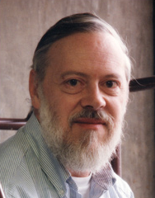
Who Developed C
The C programming language was devised in the early 1970s as a system implementation language for the nascent Unix operating system by a man named Dennis Ritchie. Derived from the typeless language BCPL, it evolved a type structure. created on a tiny machine as a tool to improve a meager programming environment, it has become one of the dominant languages of today.
←This guy

Slide 7
Where is C used?
Everywhere.
fight me irl. u wot m2 ?? u wanna bash m8
3

